Slide 1


Basics and Foundations
Introduction
Daniel Estévez-Barcia
daeb@natur.gl

Slide 2
Objectives of the course
Being comfortable in an R environment
Learn to load, clean and manipulate datasets
Perform exploratory analyses and visualization
Produce ready-to-publish results and graphs
Write scripts for future you and others
Basics and Foundations

Slide 3
Structure of the course
5-10 mins of presentation
Exercises proposals and methods
Hands on R
1 week of duration
All work will be performed with most recent versions of R and Rstudio
Basics and Foundations

Slide 4
What is R?
“R is a language and environment for statistical computing and graphics.” The R project
R is a functional language in the sense that every piece of work is performed by a function. And every function and variables are objects
Basics and Foundations

Slide 5
Why R?
It is written by the experts on the field, so you know is legit
It is free, we all can use it
Works whatever system you use (Windows, Mac or Unix)
It is open source: you can modify whatever you want (given knowledge)
It is a Jack of all trades: you can run statistics, make graphs, write papers, develop webs, etc
There is a whole community developing and using R, so whatever problem you are facing, someone have already solved and posted it
Basics and Foundations

Slide 6
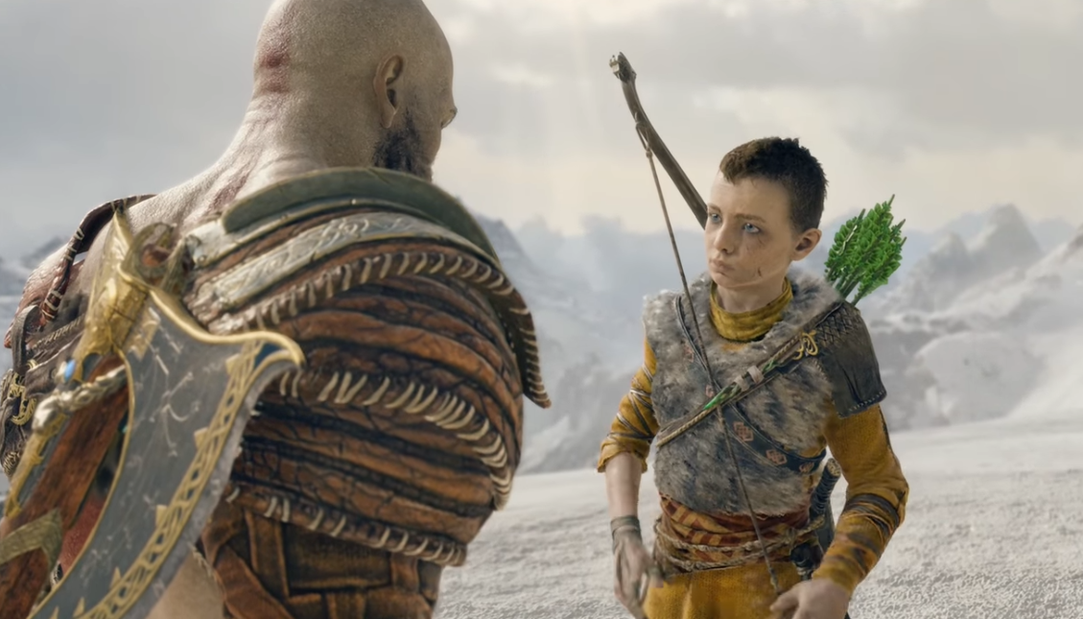
Setting up R in your computer
Pain we endure. Faulty weaponry we do not.
God of War
Always keep your skills and toolboxes in check and
update them when needed.
KEEP SHARP
Basics and Foundations

Slide 7

Let’s get all a fresh start
TO UNINSTALL
YOUR R
Follow the instructions on the PDF named “Installing R in windows”
Open the R GUI
Open Rstudio
Basics and Foundations

Slide 8
Packages
Packages are extensions of the functionality of R and contain new functions, data and help files. There are three sources for packages:
CRAN
Bioconductor (mainly bioinformatics)
GitHub (cutting edge)

Slide 9
Packages. Installing and loading
install.packages(‘package1', dependencies = TRUE)
library(package1)

Slide 10
Packages. Installing and loading
install.packages(“package1”, dependencies = TRUE)
install.packages(“package2”, dependencies = TRUE)
install.packages(“package3”, dependencies = TRUE)
.
.
.
library(package1)
library(package2)
library(package3)
.
.
.

Slide 11
Packages. Installing and loading
install.packages(“package1”, dependencies = TRUE)
install.packages(“package2”, dependencies = TRUE)
install.packages(“package3”, dependencies = TRUE)
.
.
.
library(package1)
library(package2)
library(package3)
.
.
.

Slide 12
Packages. Installing and loading
# Package names
packages <- c(“package1”, “package2”, “package3”, “…”)
# Installing packages if they are not installed
installed_packages <- packages %in% rownames(installed.packages())
if (any(installed_packages == FALSE)) {
install.packages(packages[!installed_packages])
}
# Loading packages
invisible(lapply(packages, library, character.only = TRUE))

Slide 13





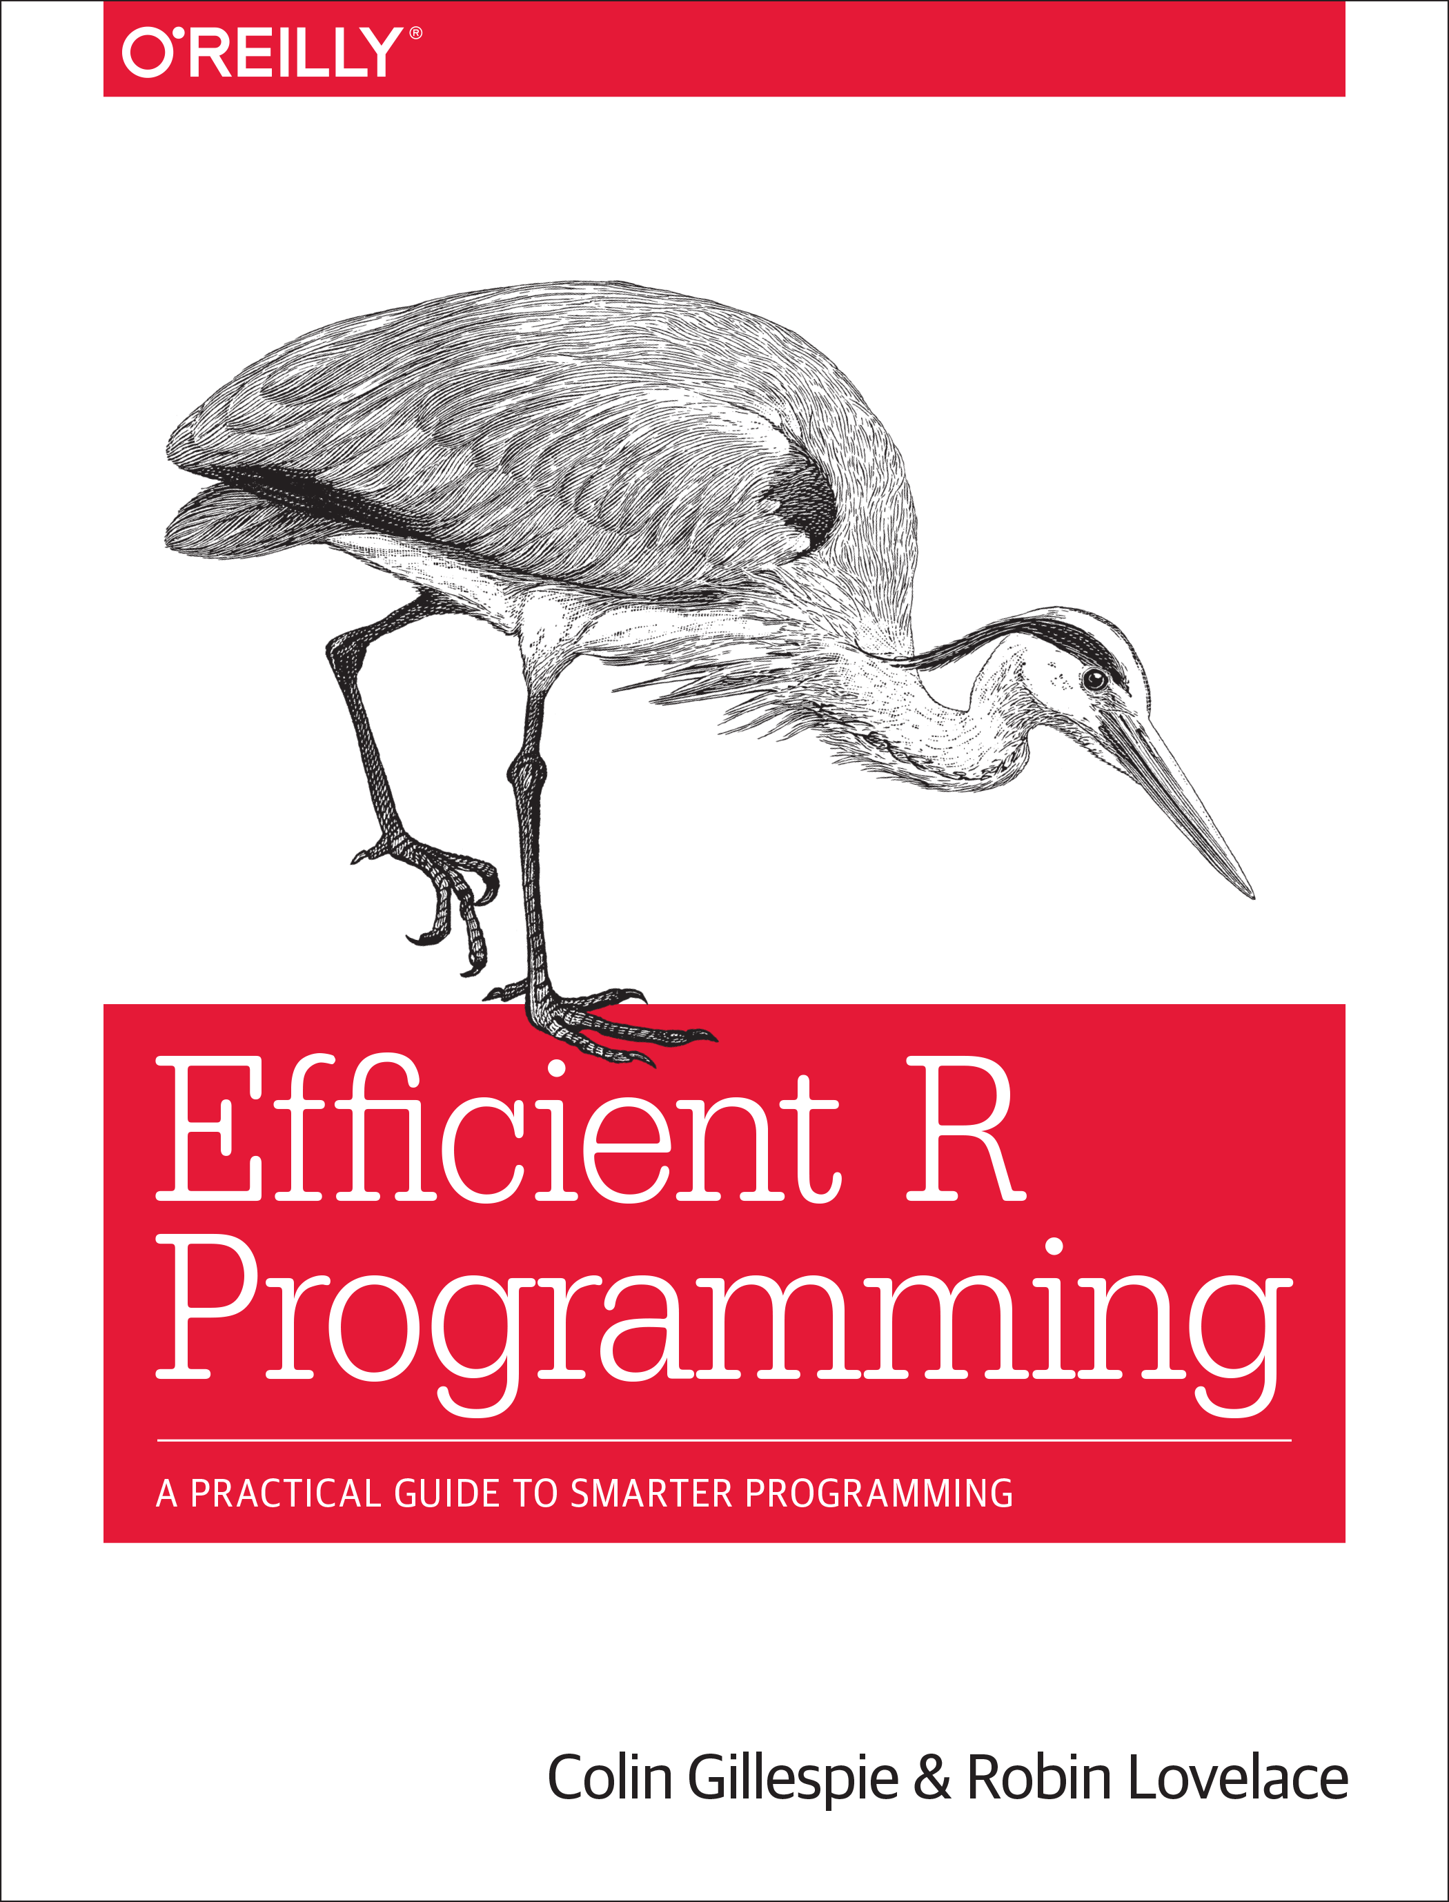
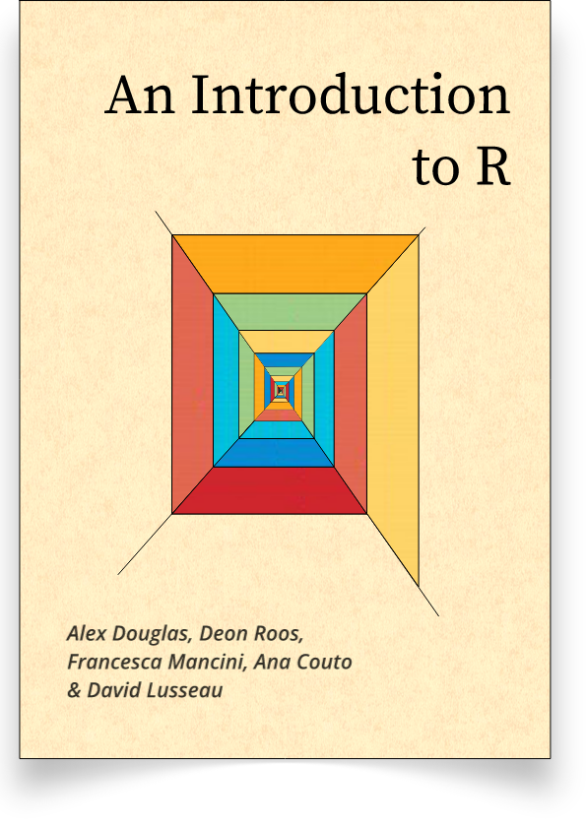

Meet your new friends:
https://blog.rstudio.com/
https://rpubs.com/
https://www.data-to-viz.com/
https://stat545.com/
https://r4ds.had.co.nz/
https://csgillespie.github.io/efficientR/
https://intro2r.com/
https://stackoverflow.com/
Basics and Foundations

